Slide 1

Natural Language Processing Bag of words TF-IDF

Slide 2
Bag of words
The bag-of-words (BOW) model is a representation that turns arbitrary text into fixed-length vectors by counting how many times each word appears.
Bag of words gives us two things: 1. A vocabulary of words for the corpus 2. The frequency of these words (number of times it has occurred in the whole corpus).

Slide 3
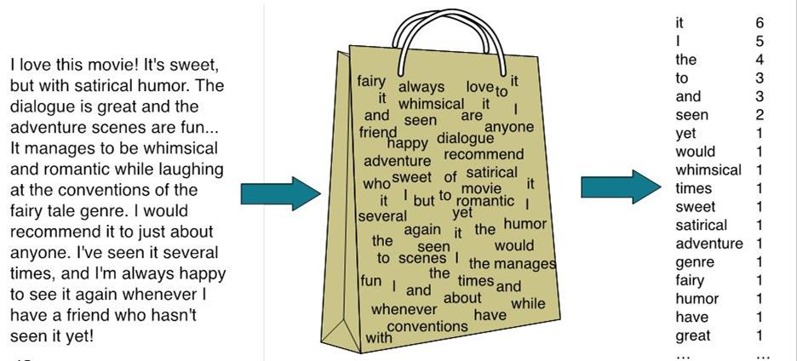

Slide 4
How to make a bag of words
Let’s understand this with an example. Suppose we wanted to vectorize the following:
the cat sat
the cat sat in the hat
the cat with the hat
We first define our vocabulary, which is the set of all words found in our document set.
The only words that are found in the 3 documents above are:
the, cat, sat, in, the, hat, and with.

Slide 5
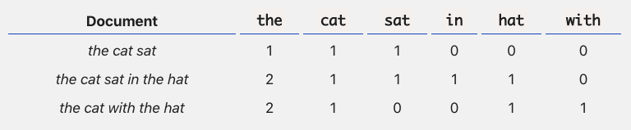
Count the words and make vectors
the cat sat: [1, 1, 1, 0, 0, 0]
the cat sat in the hat: [2, 1, 1, 1, 1, 0]
the cat with the hat: [2, 1, 0, 0, 1, 1]

Slide 6
Limitation
Notice that we lose contextual information, e.g. where in the document the word appeared, when we use BOW.
It’s like a literal bag-of-words: it only tells you what words occur in the document, not where they occurred.

Slide 7
TFIDF

Slide 8
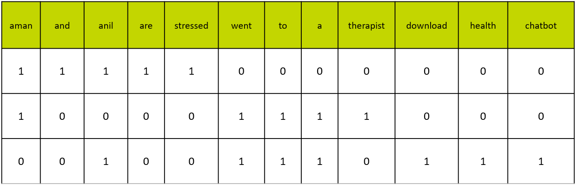
Dataset
Document 1: Aman and Anil are stressed Document 2: Aman went to a therapist Document 3: Anil went to download a health chatbot

Slide 9
Term Frequency
Term frequency is the frequency of a word in one document. Term frequency can easily be found from the document vector table as in that table we mention the frequency of each word of the vocabulary in each document.

Slide 10
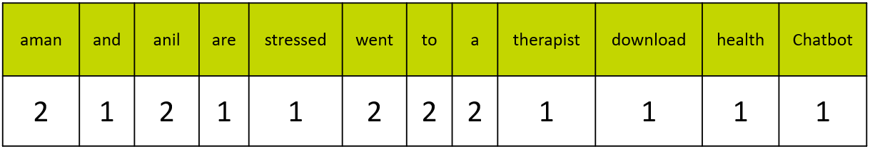
Inverse Document Frequency
Document Frequency is the number of documents in which the word occurs irrespective of how many times it has occurred in those documents.
The document frequency for the exemplar vocabulary would be:

Slide 11
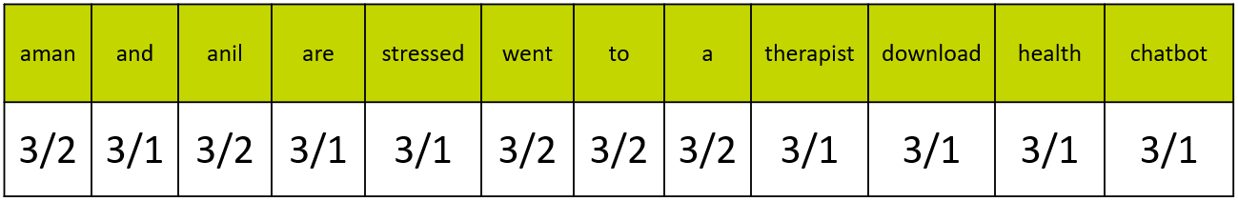
TFIDF
To find, Inverse Document Frequency, we need to put the document frequency in the denominator while the total number of documents is the numerator.
Here, the total number of documents are 3, hence inverse document frequency becomes:

Slide 12
TFIDF
Finally, the formula of TFIDF for any word W becomes: TFIDF(W) = TF(W) * log( IDF(W) )
Here, log is to the base of 10.
Now, let’s multiply the IDF values to the TF values.
Note that the TF values are for each document while the IDF values are for the whole corpus.
Hence, we need to multiply the IDF values to each row of the document vector table.

Slide 13
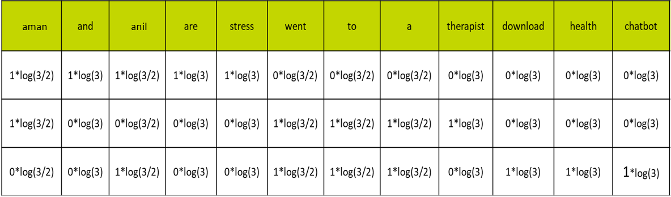
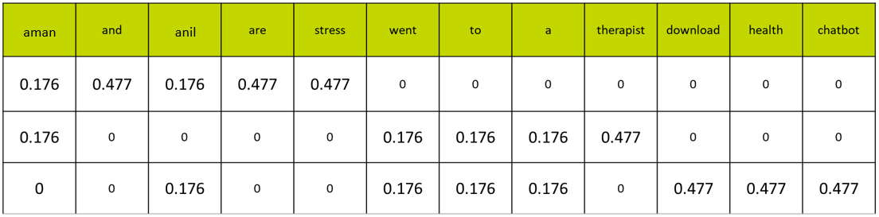
TFIDF

Slide 14
Observations
Finally, the words have been converted to numbers.
These numbers are the values of each for each document.
Here, you can see that since we have less amount of data, words like ‘are’ and ‘and’ also have a high value.
But as the IDF value increases, the value of that word decreases.

